Slide 1
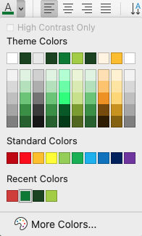
*IMPORTANT*
Please SAVE this template to your computer before editing
Please DELETE this slide when your presentation is complete
POWERPOINT TEMPLATE
AND GUIDELINES
Use the following guidelines and template for preparing your PowerPoint slides:
Our brand is designed to look as consistent on screen as in print. Therefore, the same elements such as typography and slide layout outlined here should be applied to our PowerPoint presentations. As a general rule, PowerPoint slides should never be overcrowded, allow space around each slide. This simple template has been created that can work effectively across all departments and presentations.
Templates for this PowerPoint has been created to ensure consistent production. Please contact the Sprouts Marketing team for further assistance.
FONTS
For proportional/consistent text, please use Lexend for headlines and body copy
COLORS
There are 3 greens that make up our primary color palette. Additional Brand colors can be found in the color palette under ”Theme Colors” at the top.
Please use Sprouts Green for headlines and Forest Green in place of black for copy.
Forest Green: #1A4420
Sprouts Green: #007932
Fresh Green: #A1CD3A
LAYOUT
This template contains the following pre-designed slide layouts for your use:
Title Slide
Content Slides
Divider Slide
Thank You Slide
To apply the alternate page layouts listed above click the pull down for SLIDE or LAYOUT in your top navigation and select from the options available.
If you experience any technical issues with these presentation slides, please contact marketing@sprouts.com

