Slide 1
New Test Kitchen
Project Status Update
August 2023

Slide 2
Rationale for the Redesigned Kitchen and Sensory Areas
Test products the way consumers will prepare them
Dedicated Quality and Sensory Testing areas
New Dining Room /Presentation Area
Expanded Culinary Kitchen area and cooking
New Tasting Rooms to use with Vendors
Fit for Future Facility

Slide 3
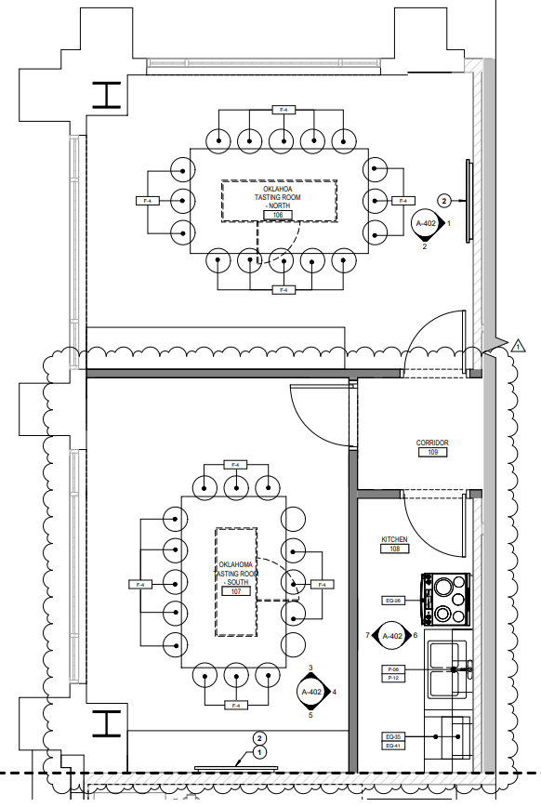
Conceptual Layout of new Tasting Areas replacing OK Room

Slide 4
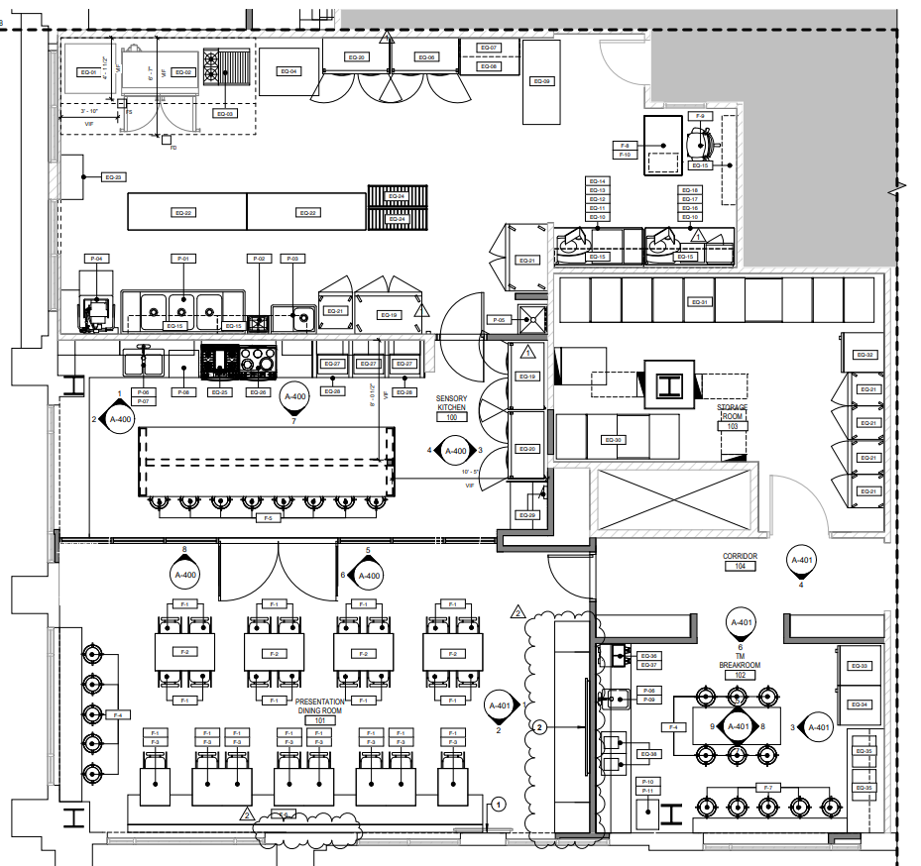
Conceptual Layout of new Sensory; Kitchen & new Break Room

Slide 5
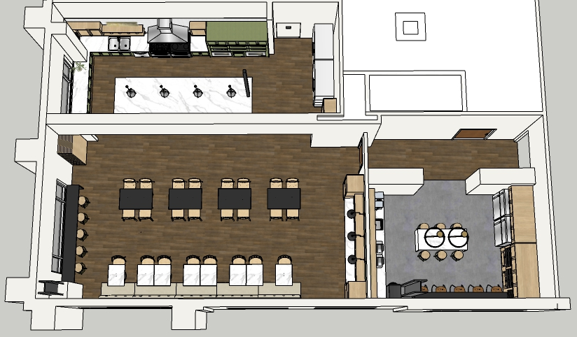
Detailed Layout
Conceptual Layout
Sensory Kitchen
Presentation Dining Room
TM Breakroom

Slide 6
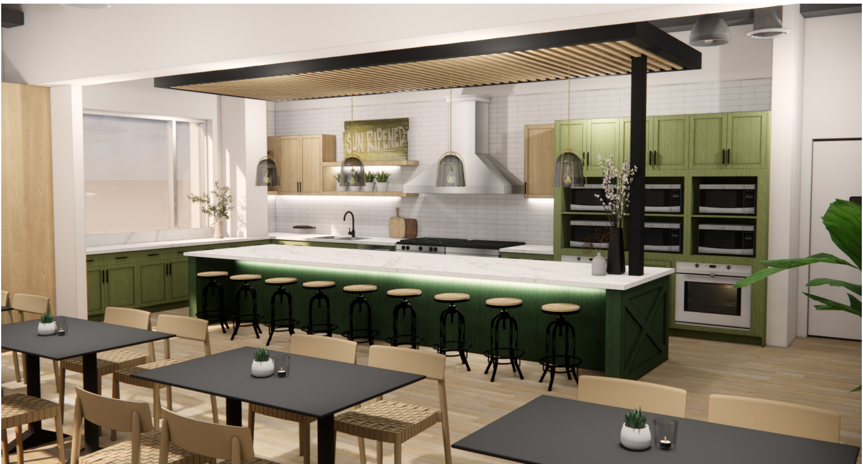
3D Model Images – New Sensory Kitchen
Conceptual Layout
Key Features:
Consumer appliances
Increased supplies storage
Chill/frozen
Enhanced Lighting
10-15 TM’s capacity

Slide 7
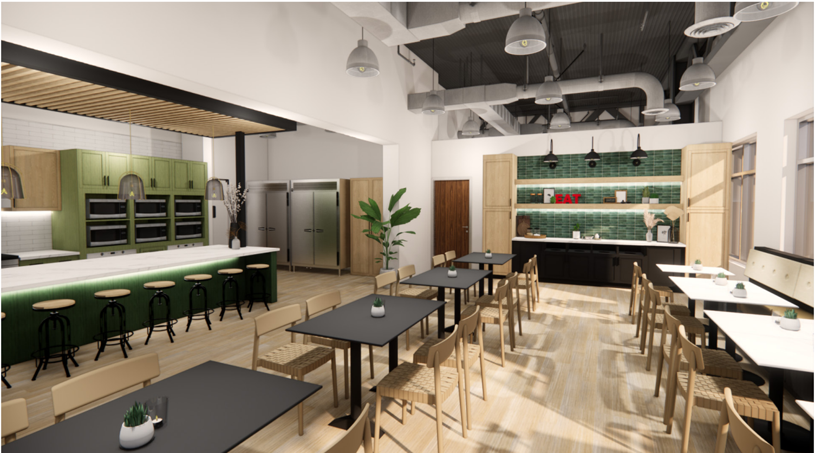
3D Model Images - Presentation Dining Room
Conceptual Layout

Slide 8
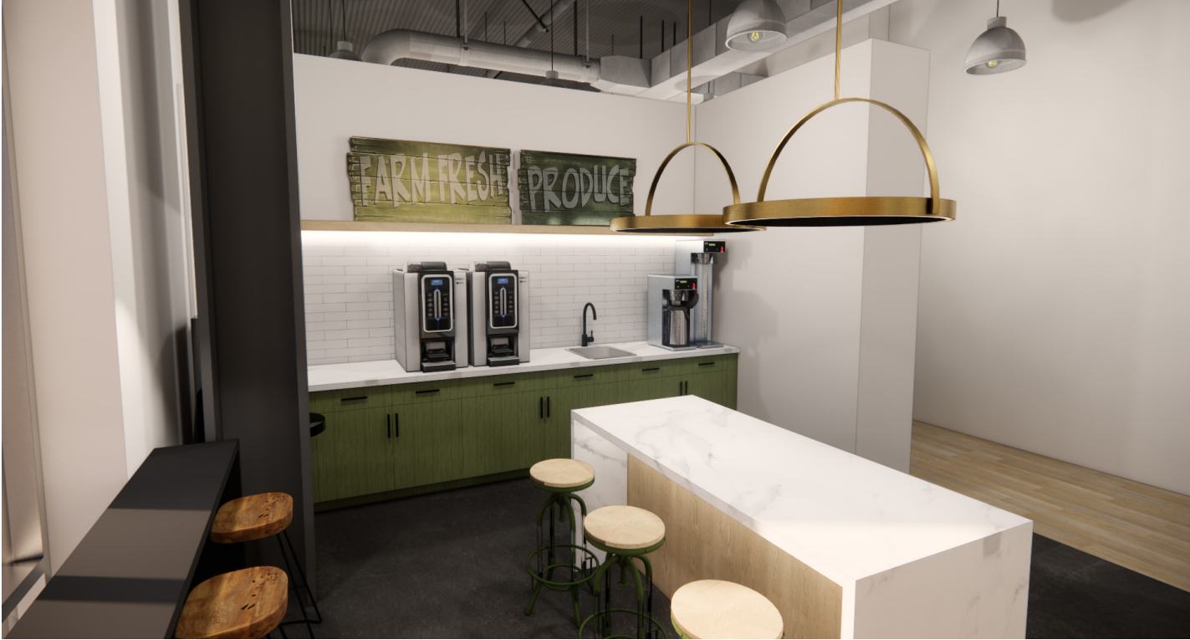
3D Model Images - New TM Breakroom
Conceptual Layout

Slide 9
Project Timeline and Key Tasks
Tasks | Time
Award Contract to final GC | Completed
Overall Construction Timeline | Aug 28 – Dec 15
OK Room Construction (Phase 1) | Aug 28 – Sep 15
No bookings in OK Room | Aug 24th onwards
Kitchen and Sensory Areas Construction (Phase 2) | Sep 18 – Dec 15
Clean up of Culinary; 3rd floor breakroom and storage areas | Week of Sep 11
Galley Kitchen and OK Tasting Room South (Culinary Use only) | Sep 15 – Dec 31
Merchants use OK Tasting Room North for product storage | Sep 15 –Dec 31
New Areas available for general booking / use | Jan 1st

Slide 10
Key Mitigations
Issue | Mitigation
One net loss of office near 3rd floor west | Moves planned and executed
Some noise and dust (3rd floor) | Hotel spaces on 2nd floor – Also some spaces on 4th floor – reserved on first come first serve
Cooking spaces will be limited (Galley Kitchen; Breakrooms only) | Use alternate spaces
Sensory approvals and Quality Testing | Use alternate spaces (Other breakrooms; Ricky's office; Jac's office)

