Slide 1
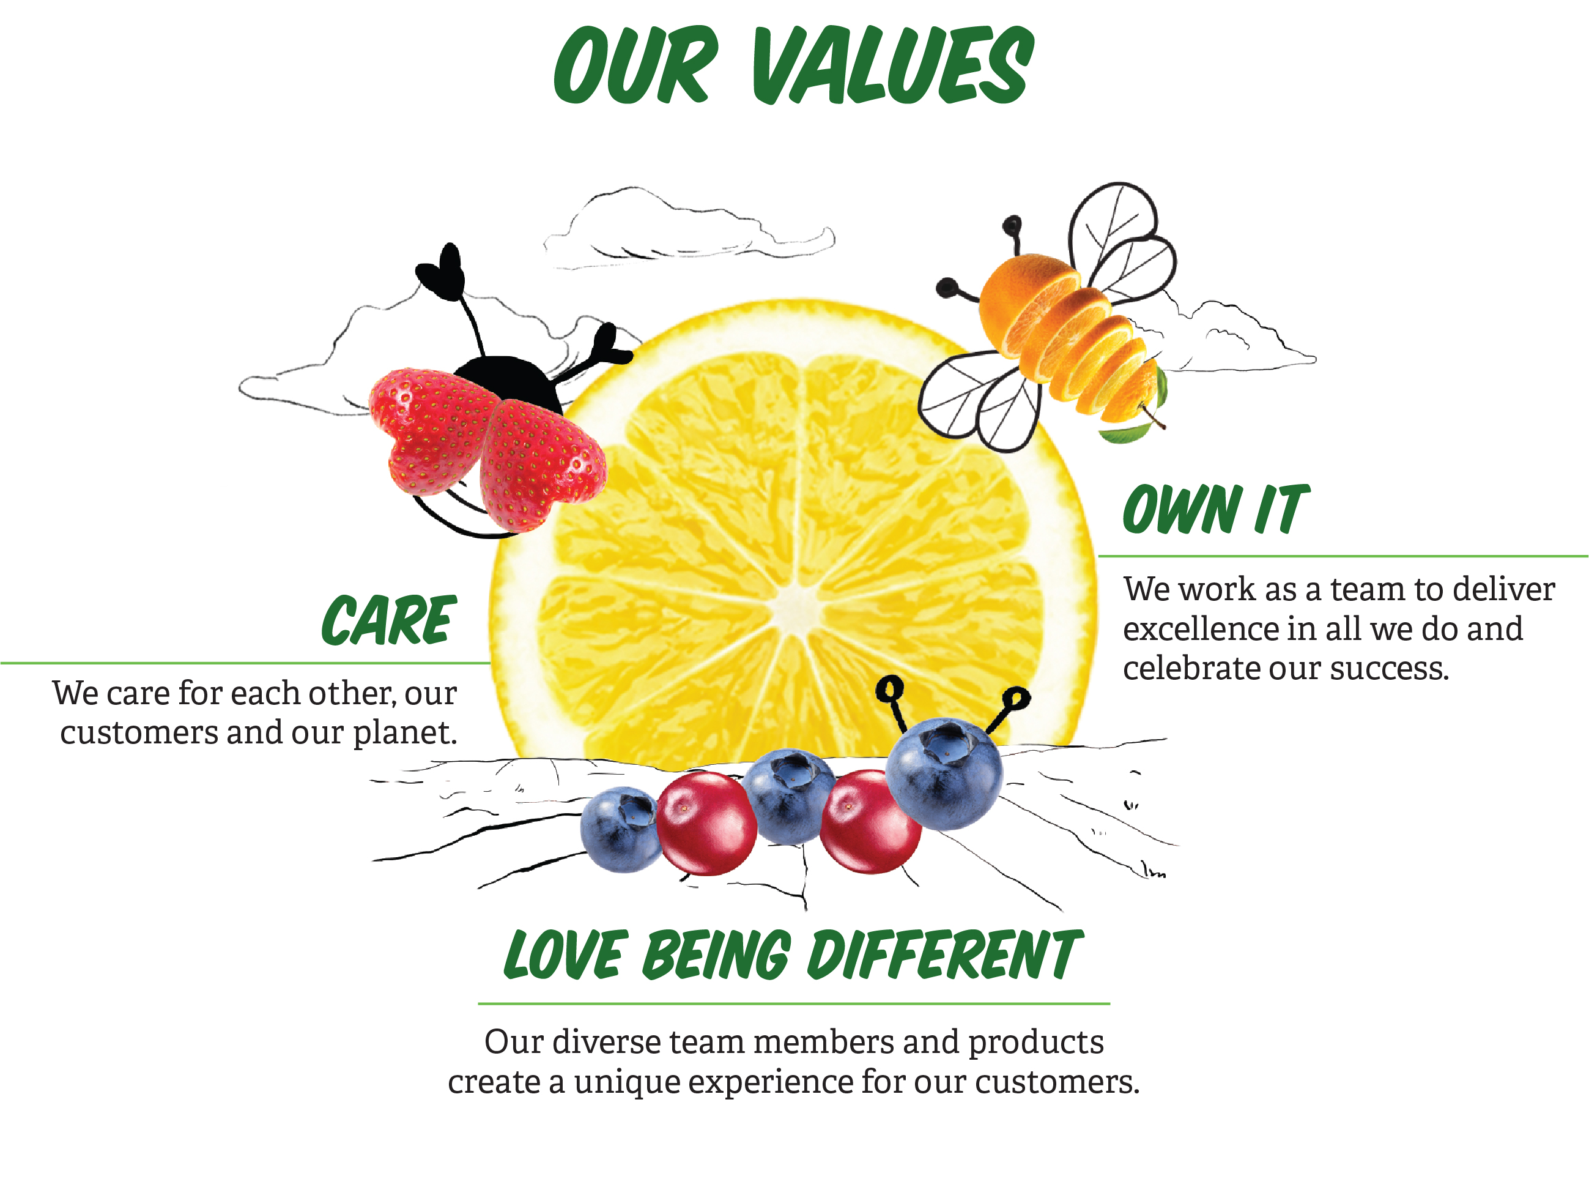
SPROUTS VALUES

Slide 2
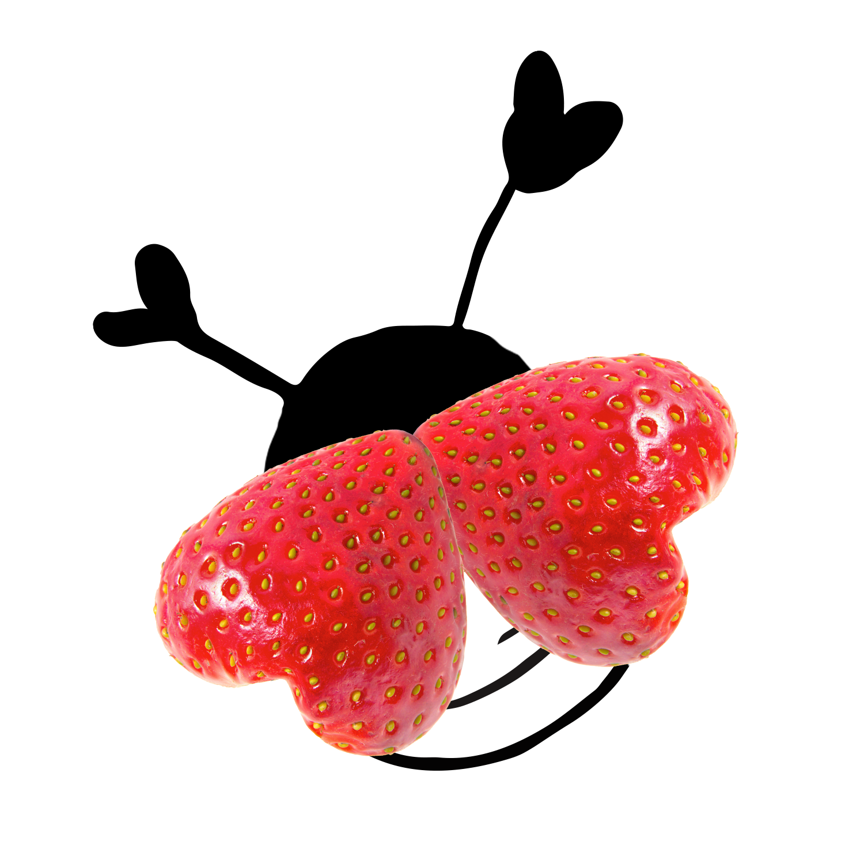
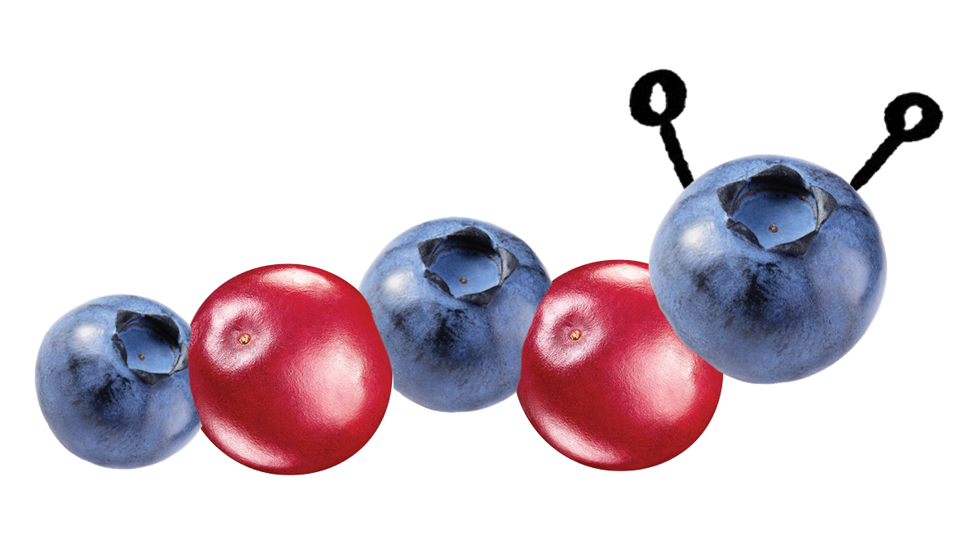

SPROUTS VALUES
BEHAVIORS
How to demonstrate the values:
Some of the ways I show I care:
I focus on our customers and resolve concerns quickly
I regularly give feedback to the people I work with
I listen to others
I support my team and recognize good work
I recycle and am careful about the food waste I create
How will you show that you care?
Some ways I love being different:
I celebrate differences in others
I have a positive attitude
I understand our products and look for ways to help our customers
I take calculated risks and learn from my mistakes
I look for ways to be innovative and regularly share my ideas
How will you demonstrate that you love being different for our team members and our customers?
Some ways I own it:
I accept responsibility for the company’s success and my goals
I do what I say I will do
I recognize others when they deliver on their commitments
How do you own the actions you take and the behaviors you show?

